Slide 1
Contemporary Issues
Review the module requirements.
What is contemporary?

Slide 2
Contemporary
living or occurring at the same time.
"the event was recorded by a contemporary historian“
belonging to or occurring in the present.
"the tension and complexities of our contemporary society"

Slide 3
Module Aims
to address contemporary issues in education and training
content will be expected to change and develop in response to current concerns
a constant core of themes central to the national debate and these will include…

Slide 4
… themes central to the national debate
identification of significant aspects of government legislation, policy and control
management strategies and styles
funding and performance indicators
quality assurance and inspection
unemployed youth and vocationalism
innovations in curriculum, teaching, learning and assessment
access to education.

Slide 5
Assignment Criteria
Critically review a contemporary issue of choice which has relevance to his/her particular teaching situation
Analyse and examine the impact of the contemporary issue in the context of current philosophies and policies within post-16 education sector;
Identify and appraise the strategies adopted by employers as a response to factors relating to the identified issue (e.g. constraints, opportunities and innovations) identifying the strengths and limitations to responses made.
Analyse how chosen issue impinges on them as practitioners and student experience in particular;
Reflect on the strategies they use to ensure consistency of practice despite the constantly changing external landscape

Slide 6
Requirements of CI
You consider your issue in terms of the macro-meso-micro approach
Why has government raised the issue?
What is the impact on colleges-teachers-learners?
In essence the report is based on a literature review and not your research
You need to ensure there is enough literature on your topic i.e. can it be linked to government policy or a review e.g. The Wolfe Report

Slide 7
Activity 15 mins – Education News
Use one of the websites below identify a current issue in education.
Explain your issue and opinion on it in to the class next week in no more than 1 min.
www.tes.com
https://www.gov.uk/government/organisations/department-for-education
http://feweek.co.uk/
https://www.gov.uk/government/organisations/ofsted

Slide 8
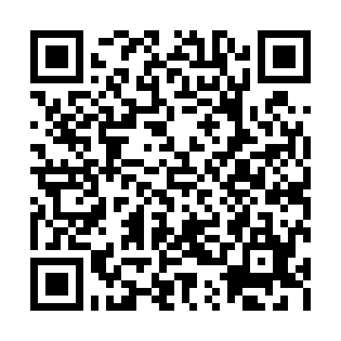
Activity - DfE White Paper
Read the executive summary from the article below and identify a section that gains your attention.
Write a paragraph on what could be the implications for colleges, teachers, learners?
Department for Education (2010) The Importance of Teaching The Schools White Paper 2010. London: The Stationery Office. Available at:
http://www.educationengland.org.uk/documents/pdfs/2010-white-paper-teaching.pdf

Slide 9
Activity - Statement of Intent
Read the content of the statement
If you have an idea complete for the next session
If not bring a list of ideas

